Slide 1
Determination of Alkalinity
Dr. P. G. Umape
Engineering Chemistry
First Year Engineering Department

Slide 2

It is the ability of water to react with standard acid
Why It has ability to react?
What is alkalinity?
Due to presence of –OH, CO₃²⁻ , HCO₃⁻.
–OH + H⁺ H₂O
CO₃²⁻ + H⁺ HCO₃⁻
HCO₃⁻ + H⁺ H₂O + CO₂
What is the reaction?
Based on the nature of anion alkalinity can be classified as
Hydroxide alkalinity (–OH )
Carbonate alkalinity (CO₃²⁻)
Bicarbonate alkalinity (HCO₃⁻)

Slide 3
Effects of Alkalinity
Higher the alkalinity higher will be hardness
Have a bad taste
It causes lime scale to build up on plumbing fixtures and pipes.
Hard water can also create a scum like appearance on clothing and dishware.
Higher alkalinity leads to health effects.

Slide 4
How to Determine alkalinity?
It can be determined by titration method
Water sample is titrated with standard acid
Two indicators are used
Phenolphthalein
Methyl orange
End point
Pink to colourless
⁻OH, CO₃²⁻
HCO₃⁻
Yellow to orange

Slide 5
Theory to determine alkalinity
Alkalinity is determined by titrating water sample with standard strong acid.
Two indicators used
Phenolphthalein (Pink to colorless)(pH = 8.2)
Methyl orange (yellow to orange)(pH = 4.4)
Reactions:
⁻O H + H⁺ → H₂O
CO₃⁻² + H⁺ → HCO⁻₃
HCO⁻₃ + H⁺ → H₂O + CO₂
Here P = Phenolphthalein, M = Methyl orange
P
M

Slide 6

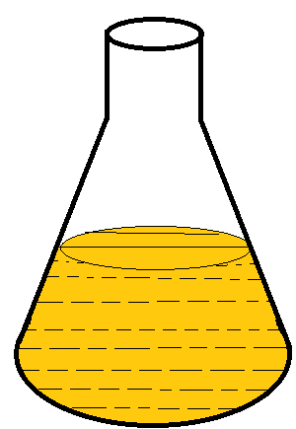
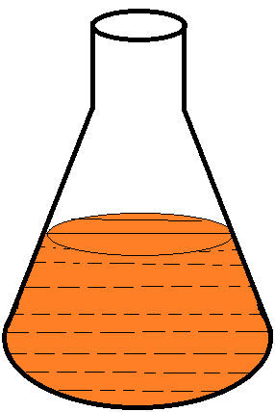
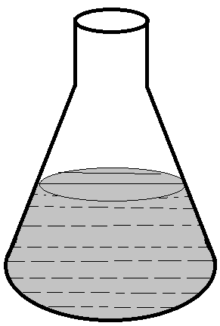
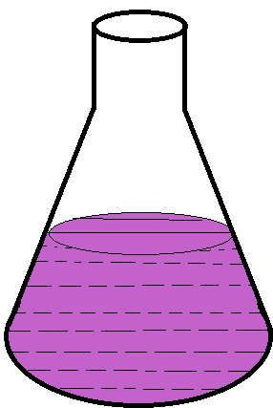
Procedure
0.0 ml
Fill The burette by N/50 Acid
V₁ ml
V₂ ml
Add 2 drops of Phenolphthalein indicator
Add 2 drops of Methyl orange
indicator
Take V ml of Water sample

Slide 7
Calculation
From the titration following data obtained
Volume of water sample V ml
Normality of Acid N/50
CBR for Phenolphthalein end point V₁ ml
CBR for Methyl orange end point V₂ ml

Slide 8
Calculation
Phenolphthalein alkalinity (P) =
V₁ X Normality of acid X 50 X 1000
ppm CaCO₃ equivalent
=
Volume of water sample
Methyl orange alkalinity (M) =
V₂ X Normality of acid X 50 X 1000
ppm CaCO₃ equivalent
=
Volume of water sample

Slide 9
Calculation
Alkalinity | Quantity of OH⁻ | Quantity of CO₃⁻² | Quantity of HCO₃⁻
P =0 | 0 | 0 | M
P =1/2M | 0 | 2P | 0
P = M | P | 0 | 0
P < 1/2M | 0 | 2P | M-2P
P > 1/2M | (2P-M) | 2(M-P) | 0

Slide 10
Assignment
Define alkalinity and give its types with example.
What is P alkalinity, Which salts are responsible for P alkalinity?
What is M alkalinity, Which salts are responsible for M alkalinity?
Explain the procedure to determine alkalinity.
How to calculate individual alkalinity?

